Slide 1

A
Power Point Presentation
Of
Major Project
On
“BOOK MY MEAL”
Department of Computer Science and Technology
SCOPE COLLEGE OF ENGINEERING
BHOPAL (M.P.)-462021
Submitted By:-
SHIVAM CHOURASIYA
(0121CA173D08)
M.C.A VIth Sem
Project Approved By: Submitted To:
mr. vinod sharma mr. vinod sharma
(Head of Department) (Assistant Prof.)

Slide 2
INTRODUCTION
The aim is to generate a web application, use to promote meal selling online. Apart from existing applications like Zomato, Swiggy or Uber Eats this application has complete focus on students going for schools, colleges and for the Employees. The main objective of this project is to provide healthy foods in every city.

Slide 3
OBJECTIVE
The main objective of this project is to provide tasty and healthy food for the school students, colleges students, office employees and for the bachelors. The people who are staying far from home can get the services at their door steps. They will getting it in the form of package, in that way they do not need to place the order everytime because they already selected a package which is scheduled for monthly basis.

Slide 4
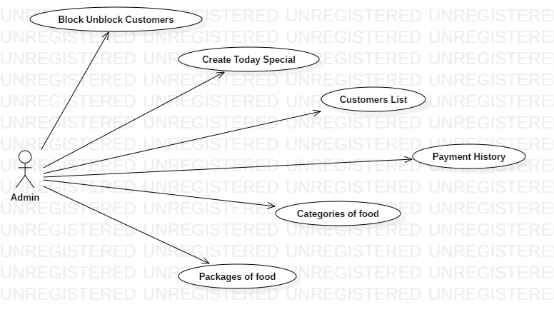
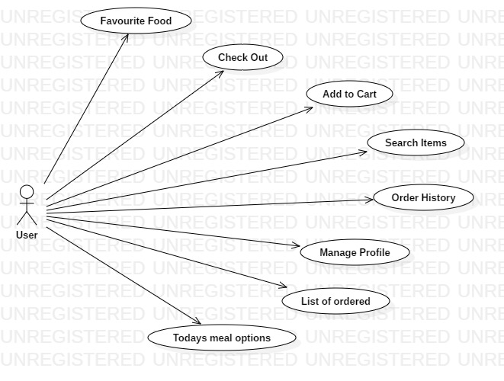
DATA FLOW DIAGRAM (DFD)
1. USE CASE DIAGRAM

Slide 5
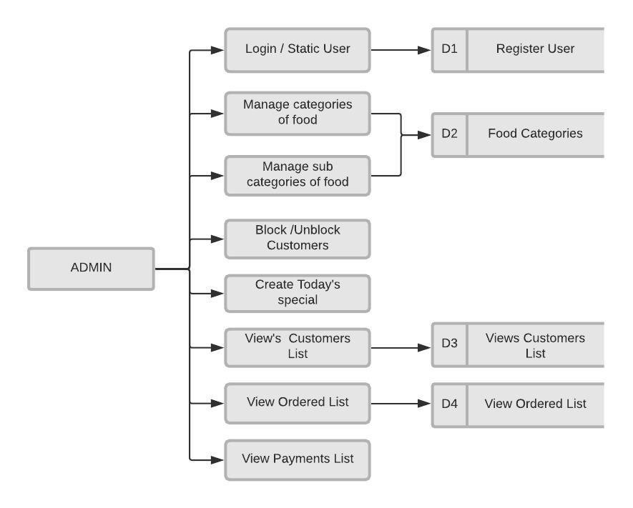
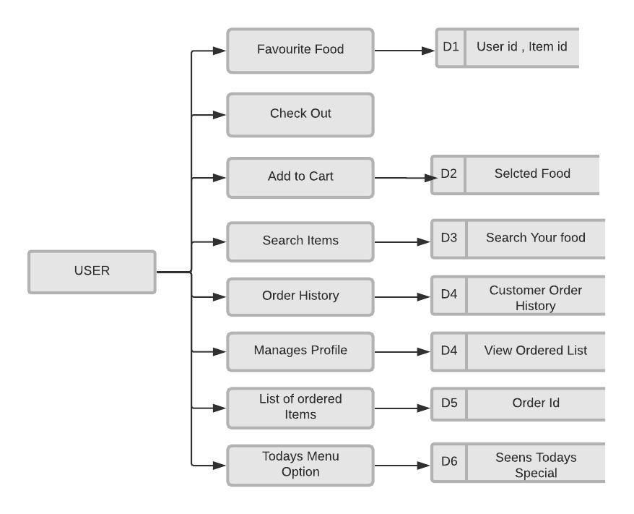
2. DATA FLOW DIAGRAM

Slide 6
PYTHON
Python is an interpreted, high-level, general-purpose programming language. Created by Guido van Rossum and first released in 1991, Python has a design philosophy that emphasizes code readability, notably using significant whitespace. It provides constructs that enable clear programming on both small and large scales. Van Rossum led the language community until July 2018.
Latest version of python is 3.7.3

Slide 7
DJANGO
Django is a high-level Python Web framework that encourages rapid development and clean, pragmatic design. Built by experienced developers, it takes care of much of the hassle of Web development, so you can focus on writing your app without needing to reinvent the wheel. It's free and open source. Ridiculously fast.
Latest version of Django is 2.1.7

Slide 8
SCREEN SHORTS

Slide 9
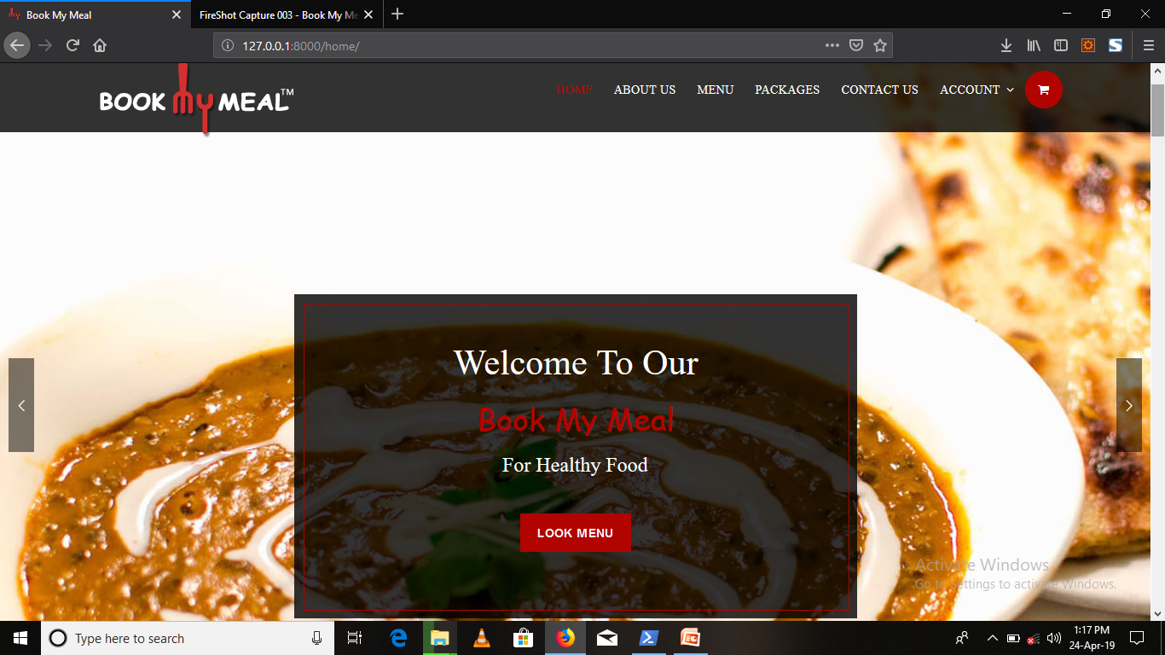
HOME PAGE

Slide 10
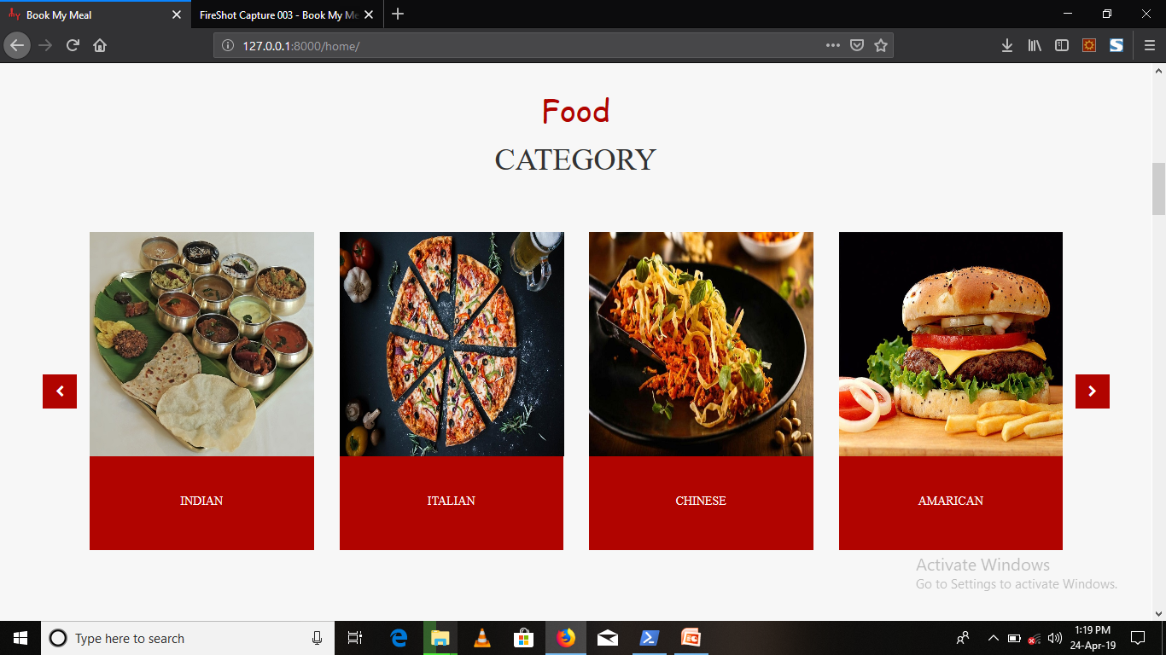
FOOD CATEGORY

Slide 11
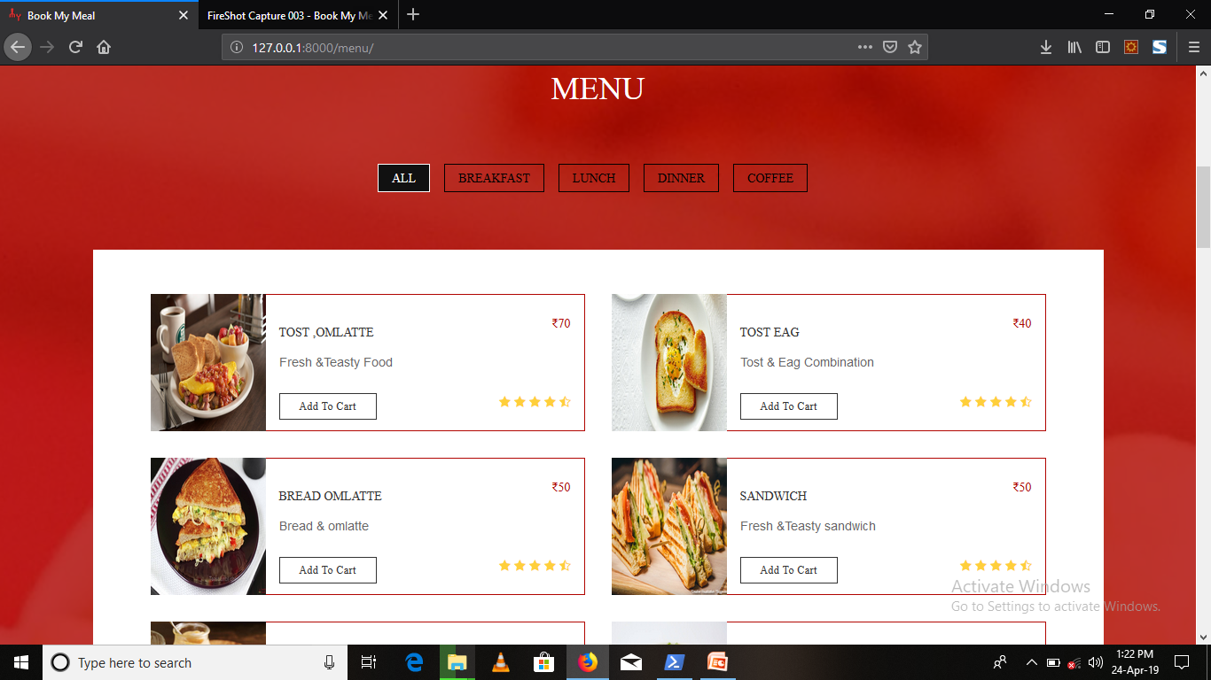
MENU

Slide 12
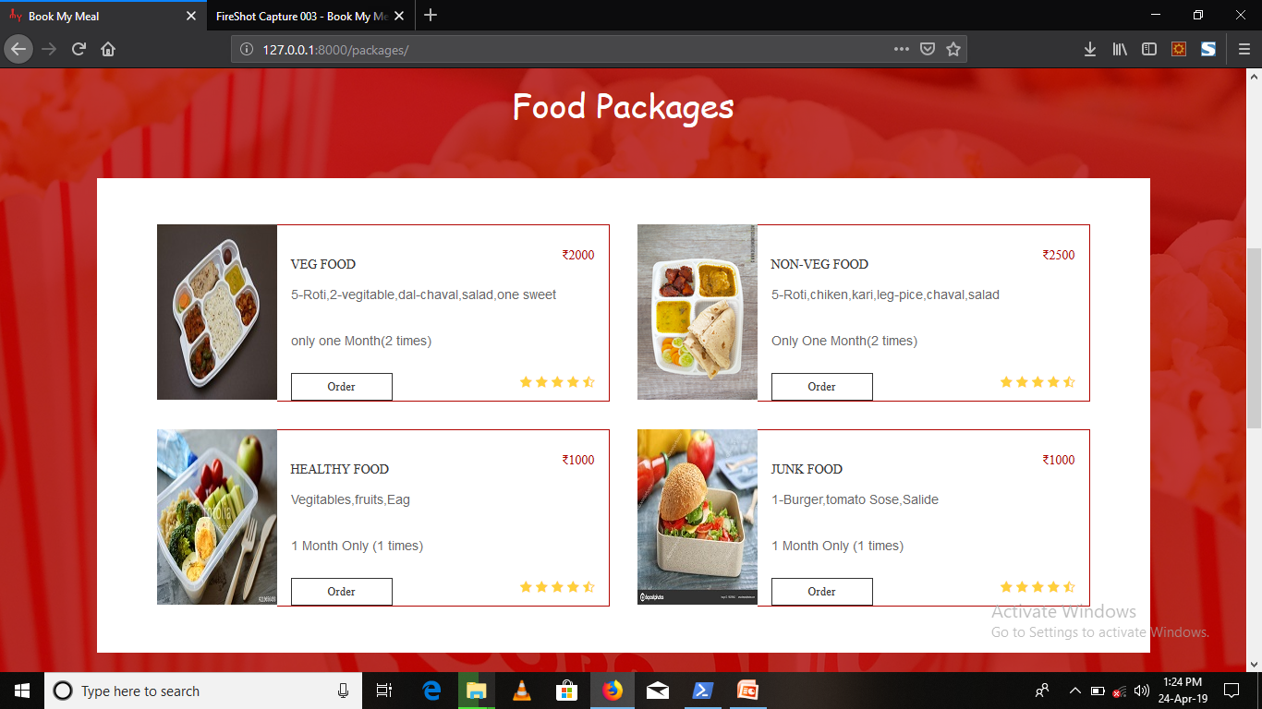
FOOD PACKAGES

Slide 13
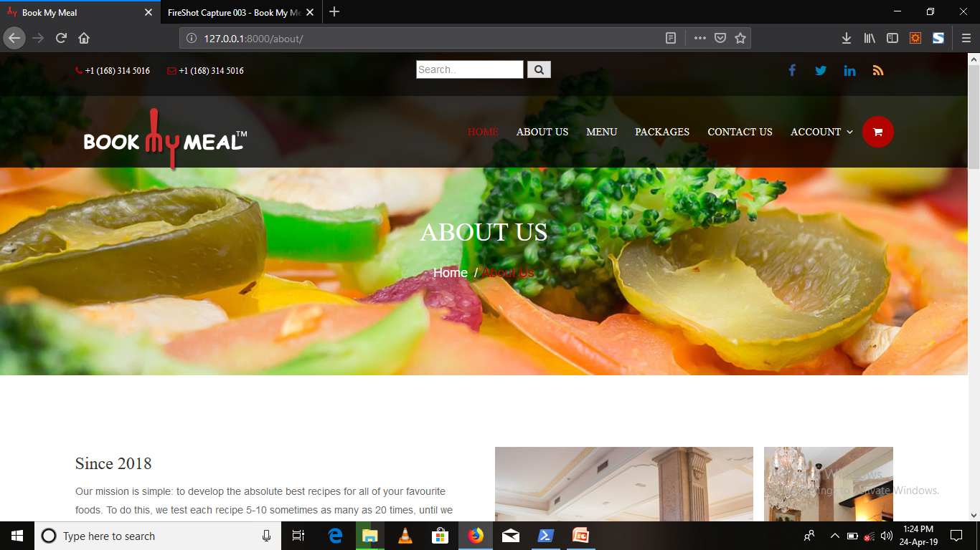
ABOUT

Slide 14
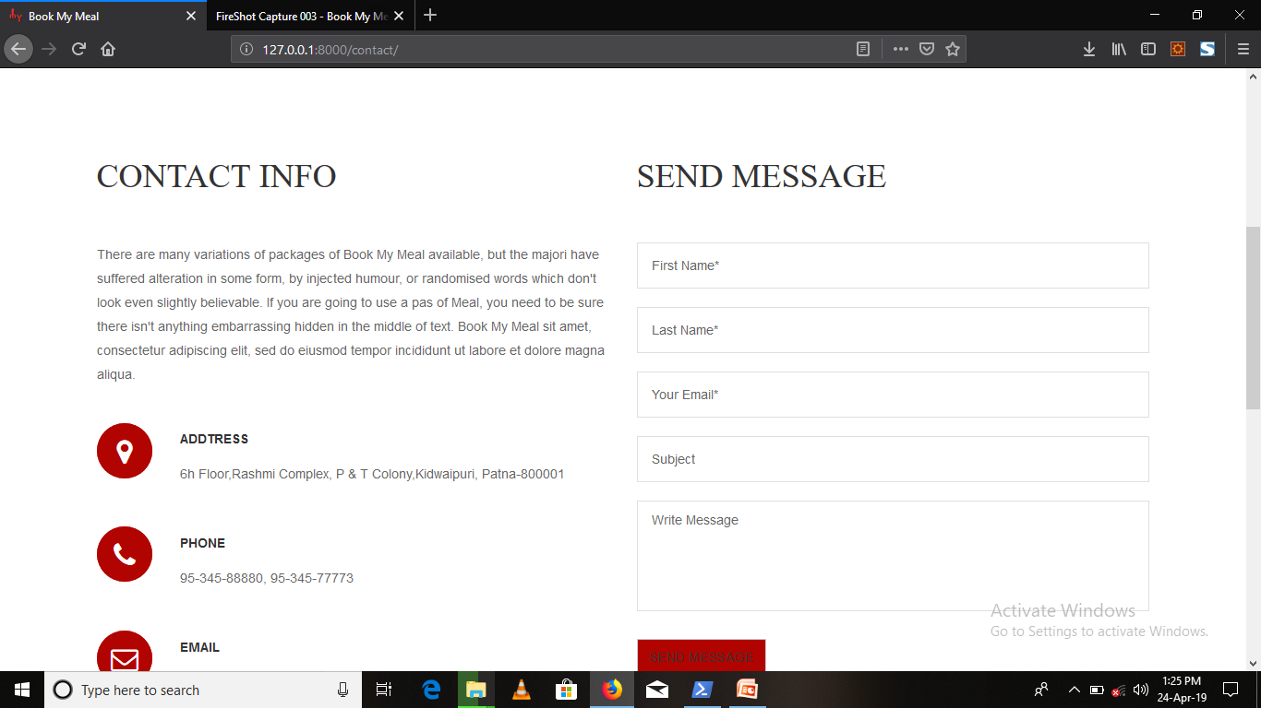
CONTACT US

Slide 15
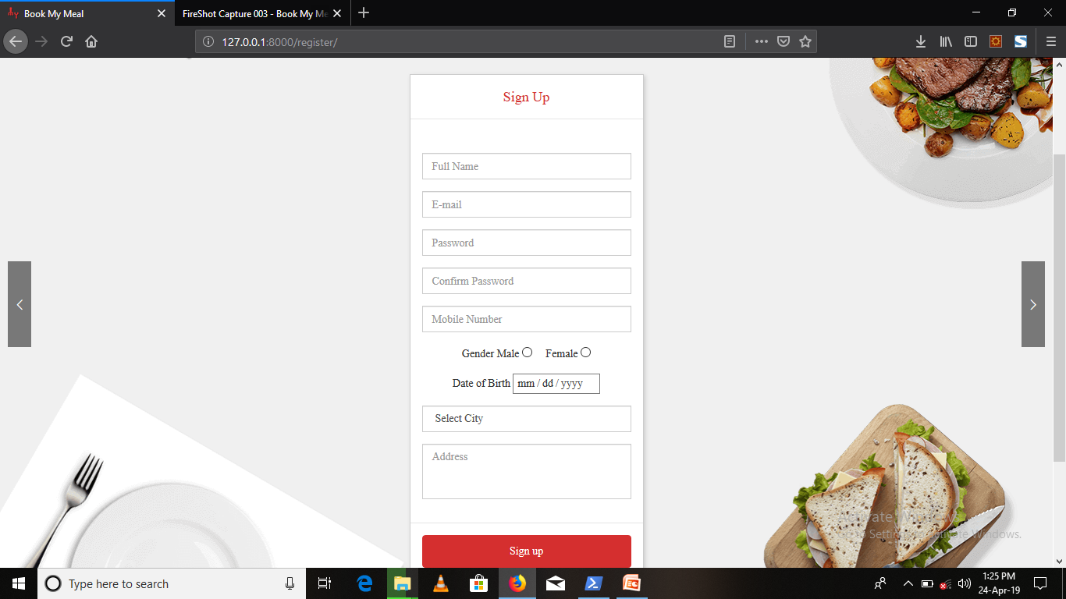
SIGN US

Slide 16
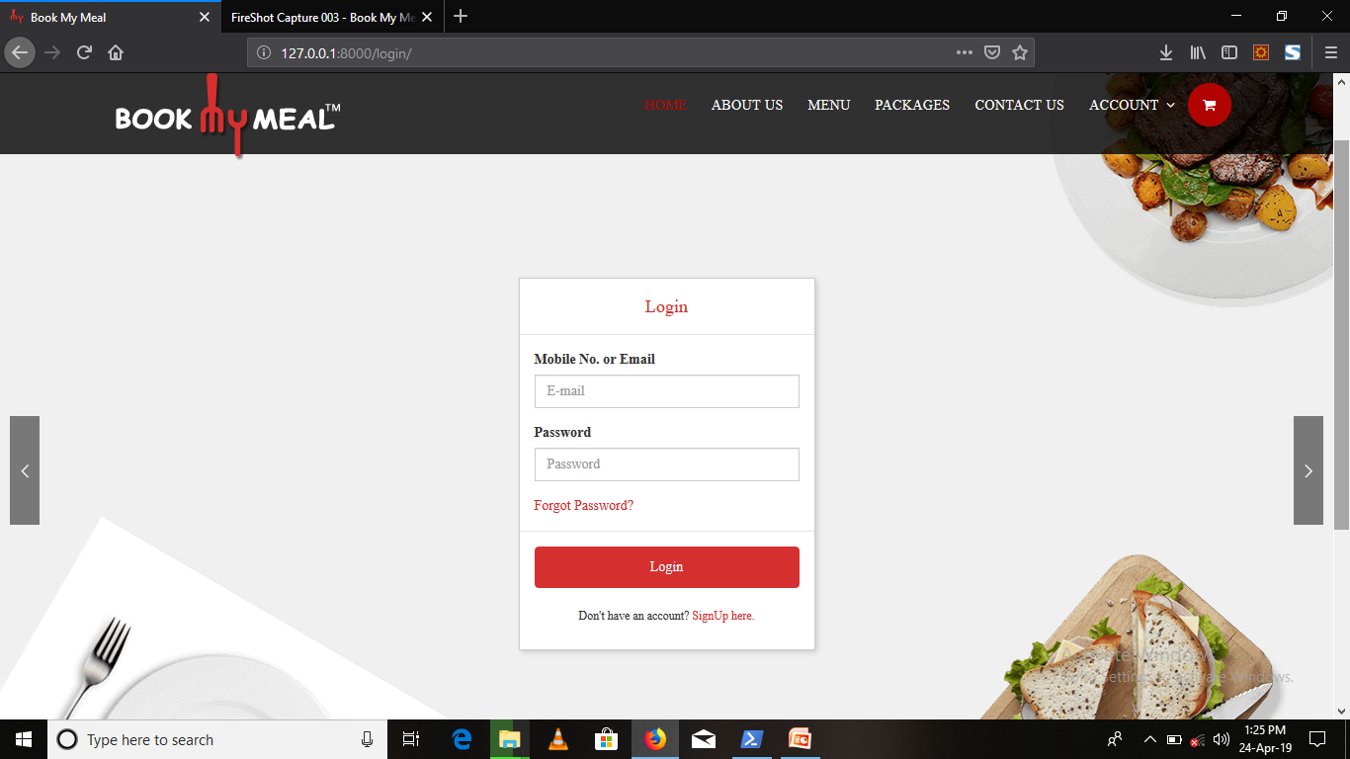
LOGIN

Slide 17
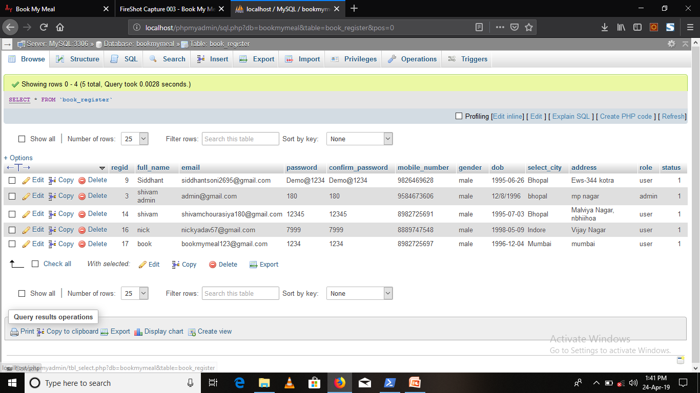
DATA BASE TABLES

Slide 18
ADVANTAGES
The main advantages of this project are as follows:-
To provide the healthy food packages to our customers.
And the customers can get the food on their scheduled time and without any delays at thier door steps.
Friendly user interface to the customers.
Online food ordering system provides a seraching facilities based on various factors.
It deals with monitoring the information and transactions of customers

Slide 19
FUTURE ENHANCEMENT
We can host the platform on online servers to make it accessible worldwide. Can provide coupons to users for discount, after order and can also provide attractive offers. On daily basis can generate offers for productivity. The implement E-wallet in application to make payment mode easy. Provide user capability to generate wish-list of products. It integrates Google AdSense. Today’s special meal features can be generated

Slide 20
CONCLUSION
Our mission is simple to develop the absolute the best receipts for all yours favorite’s foods. To do this we test each recipes 5-10 some time as many as 20 times, until we arrive at the combination of ingredients, technique, temperature, cooking time and equipment that yields the best tasteful recipt.We believe that cooking and catering is an art that is mastered through experience along with great passion for food.

